Slide 1
Supermarket: Management & Billing

Slide 2
Table of contents
Motivation
Solution possible
Introduction
WorkFlow
Project Overview
Methodology
Advantages & Disadvantages
Conclusion

Slide 3
MOTIVATION
A person entering the shopping mall does not know what are the items located in the wreck he wanted to purchase in the shopping mall.
She/he has to look for the particular item throughout the shopping mall.
They should also enquire the details about the items to call to the home

Slide 4
Solution possible
To overcome all the above discussed problems, we are developing a solution that is, instead of go the home and search items in wreck and shopping mall, we can search for the items using our mobile.
This will remove the burden on the customer.
Payment also can be done through mobile.

Slide 5
Introduction
Supermarket is the place where customers come to purchase their daily using products and pay for that.
There is a need to calculate how many products are sold and to generate the bill for the customer.
In our project and implementation we have 3 users.
First is the data entry operator who will enter the products in database
Second one is the administrator who will decide the taxes and commissions on the products and can see the report of any product.
Third one is the bill calculating operator who will calculate the bill and print.

Slide 6
Work Flow
Work in the supermarket will be done in the following way:
The product will come in the store.
Data entry operator will enter the information of the product in the Database.
The Administrator will enter the taxes and commissions for each product.
The customer will comme and take the basket with him/her and choose the product and took it to the counter
The bill calculating operator will check the product then it will match the product id then it will show its information and price and bill will be calculated band total payment will be shown
Customer will pay for the products
All the products will be packed and delivered to the customer.

Slide 7
Project overview
 Many Supermarkets use this type of billing system for a
decade. It is also improved many times according to
requirements of sellers and customers. It does the same
work that is calculating the bill, gives it to the customer
and maintain proper database. They are accurate in
calculation and printing, they also generate records.
 A new concept is also added in the billing system is that
they also maintain relationships with the customers who
purchase more products from the store regularly. System
also concerns their requirements and gives them more
commission. It also shows the overall profit and profit on a
particular product and give repots which items are
required and which have cross their expiry date.

Slide 8
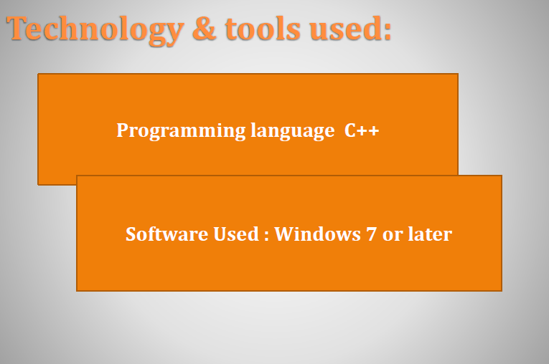
Methology

Slide 9
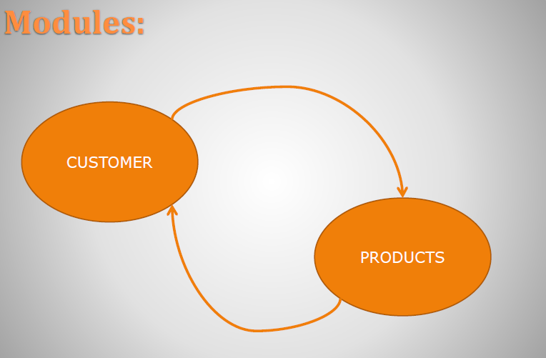

Slide 10
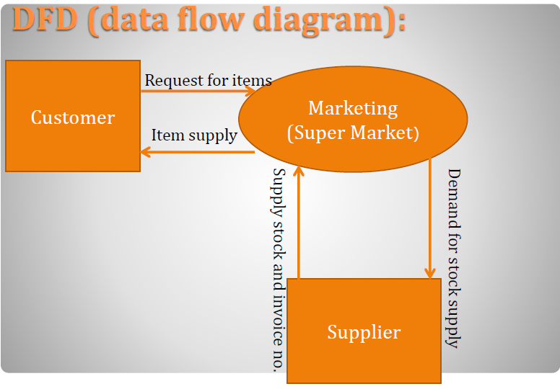

Slide 11
Advantages:
 Saving in labor due to self-service system.
 Supermarket has large turnover.
 Low cost of operation.
 Freedom of selection.
 Shopping is very easy and quick.

Slide 12
Disadvantages:
There is lack of personal attention.
It require large and extensive premises.
Goods which require explanation by
salesman cannot be sold in such markets.

Slide 13
Conclusion:
Our project and implementation is on Supermarket Billing System. We have successfully completed it. We take this opportunity to express our sense of indebtedness and gratitude to all those people who helped us in completing this project and implementation.
This project and implementation has contributed a lot to our knowledge that has proved to be a value addition for us.

Slide 14
THANK YOU

